Slide 1
Capgemini Financial Services
Independent Test Engineering and Monitoring Solutions
ISTQB Foundation Level
Chapter- 4
Test design techniques
Notes:
Add a content or an objective slide in the beginning of the presentation. The main objective is to;
Understand the defect lifecycle, be able to write defect reports effectively, to be able to use a defect tracking tool effectively

Slide 2

Agenda
Identifying test conditions and designing test cases
Categories of test design techniques
Specification-based or black-box techniques
Structure-based or white-box techniques
Experience-based techniques
Choosing test techniques

Slide 3
Identifying test conditions and designing test cases
Test condition,
Test procedure
Test case

Slide 4
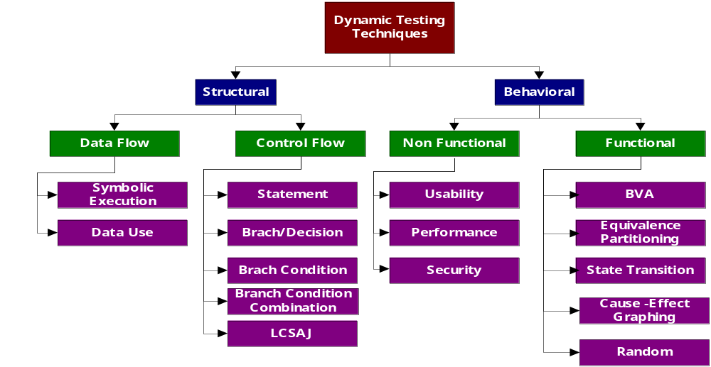
Types of Testing Techniques

Slide 5
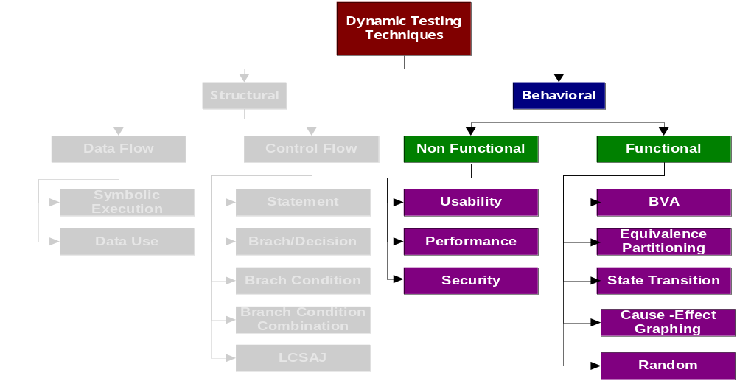
Relationship
Behavioral Techniques are Black Box Techniques

Slide 6
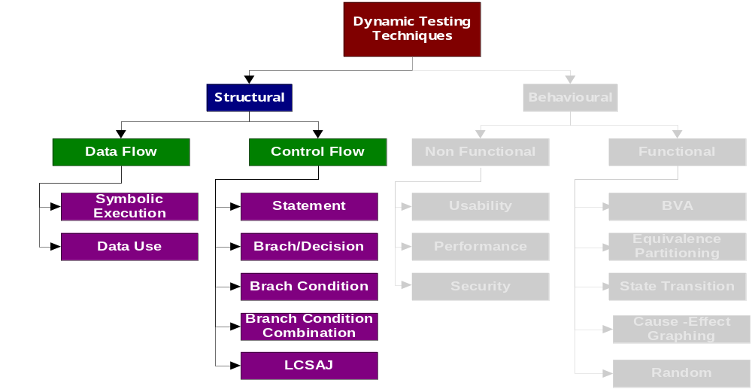
Relationship
Structural Techniques are White Box Techniques

Slide 7
Specification-based or black-box techniques
Equivalence partitioning
Boundary value analysis
Decision table testing
State transition testing
Use case testing

Slide 8
Equivalence partitioning
Equivalence Partitioning
Equivalence partitioning is a black-box testing method
- divide the input domain of a program into classes of data
- derive test cases based on these partitions.
Test case design for equivalence partitioning is based on an evaluation of equivalence classes for an input domain.
An equivalence class represents a set of valid or invalid states for input condition.
An input condition is:
- a specific numeric value, a range of values
- a set of related values, or a Boolean condition
Valid inputs
system
invalid inputs
outputs
All Rights Reserved
partition

Slide 9
Equivalence partitioning
Input data often fall into different classes where all members of a class are related
Each of these classes is an equivalence partition where the program behaves in an equivalent way for each class member
Test cases should be chosen from each partition

Slide 10
Equivalence partitioning
Partition system inputs into
‘equivalence sets’
  If input is a 5-digit integer between 10,000 and 99,999,
  equivalence partitions are <10,000, 10,000-99, 999 and >
  99,999
Choose test cases at the boundary of these
sets
  00000, 09999, 10000, 99999, 10001

Slide 11
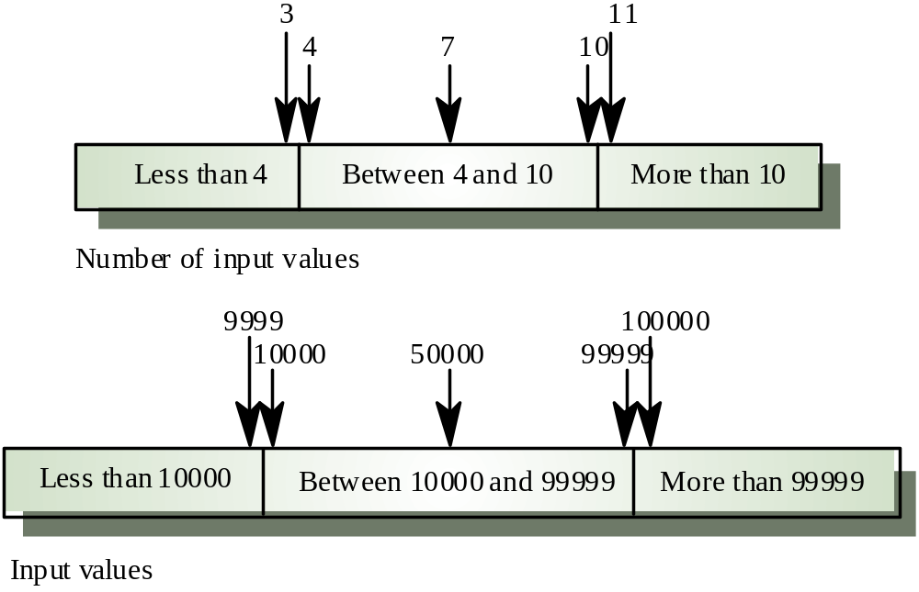
Equivalence partitions

Slide 12
Equivalence partitions
How do you determine the equivalence classes?
  examine the input data.
  few general guidelines for determining the equivalence classes can be given

Slide 13
Equivalence partitions
If the input data to the program is specified by a range of values:
  e.g. numbers between 1 to 5000.
  one valid and two invalid equivalence classes are defined.
1
5000

Slide 14
Equivalence partitions
If input is an enumerated set of values:
  e.g. {a,b,c}
  one equivalence class for valid input values
  another equivalence class for invalid input values should be defined.

Slide 15
Boundary value analysis(BVA)
Boundary Value Analysis
Boundary value analysis(BVA) - a test case design technique
- complements to equivalence partition
Objective:
Boundary value analysis leads to a selection of test cases that exercise bounding values.
Guidelines:
- If an input condition specifies a range bounded by values a and b,
test cases should be designed with value a and b, just above and below a and b.
Example: Integer D with input condition [-3, 10],
test values: -3, 10, 11, -2, 0
- If an input condition specifies a number values, test cases should be developed to exercise the minimum and maximum numbers. Values just above and below minimum and maximum are also tested.
Example: Enumerate data E with input condition: {3, 5, 100, 102}
test values: 3, 102, -1, 200, 5
Jerry Gao Ph.D. 7/20002
All Rights Reserved

Slide 16
State transition testing
State Transition Testing
• Object = state + behavior
• Behavior is the sequence of messages (or
events) that an object accepts

Slide 17
State transition testing
Key Concepts
• State: a condition in which a system is
waiting for one or multiple events
• Transition: represents change from one
state to another caused by an event
• Event: input that may cause a transition
• Action: operation initiated because of a
state change (occur on transitions)

Slide 18
State transition testing
State transition testing
• Models each state a system can exist in
• Models each state transition
• Defines for each state transition
‣ start state
‣ input
‣ output
‣ finish state

Slide 19
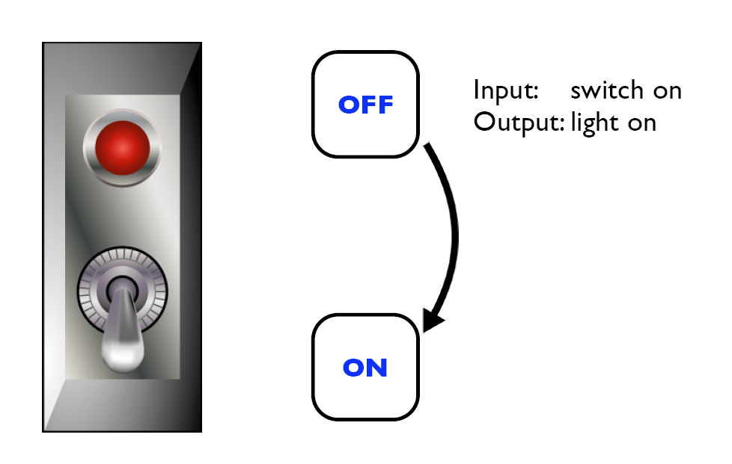
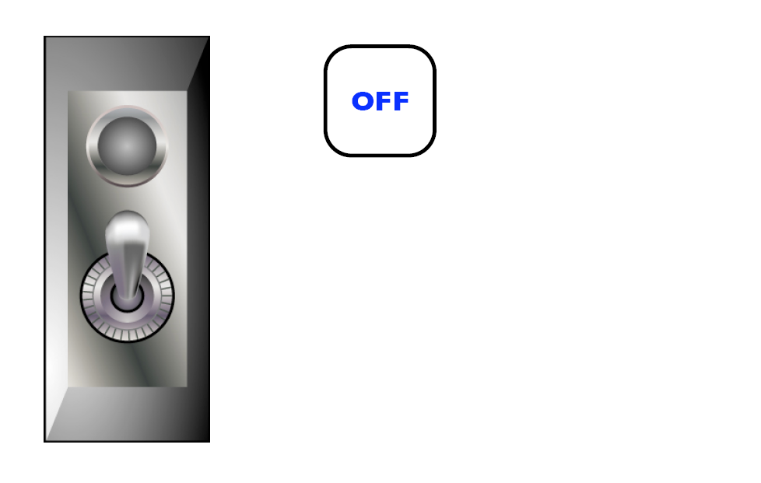
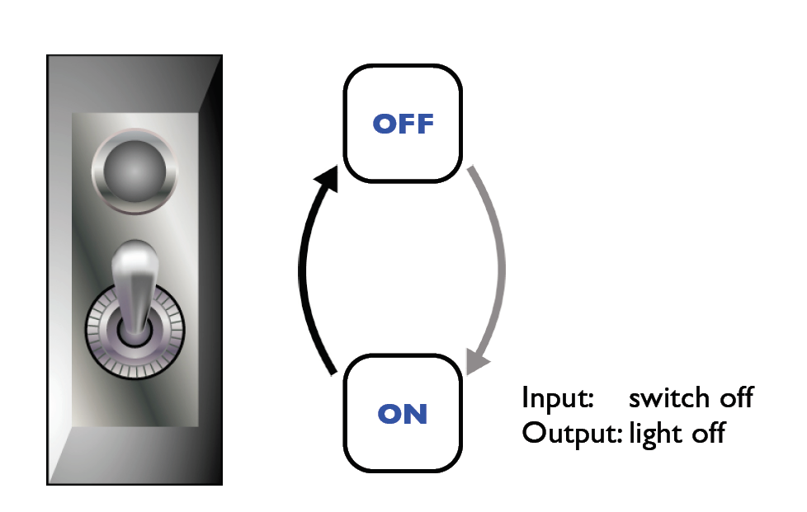
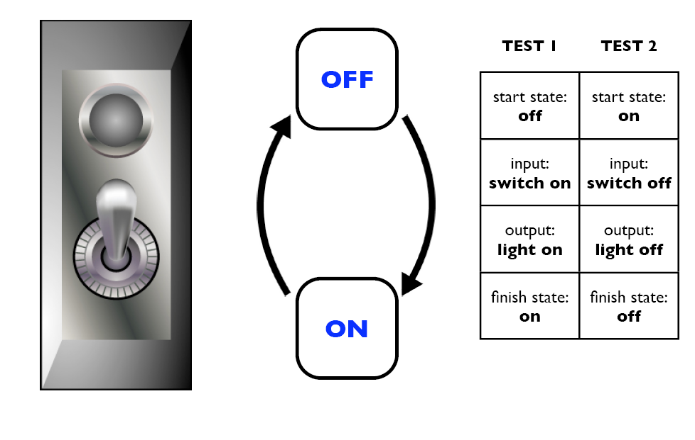
State transition testing
1
2
3
4

Slide 20
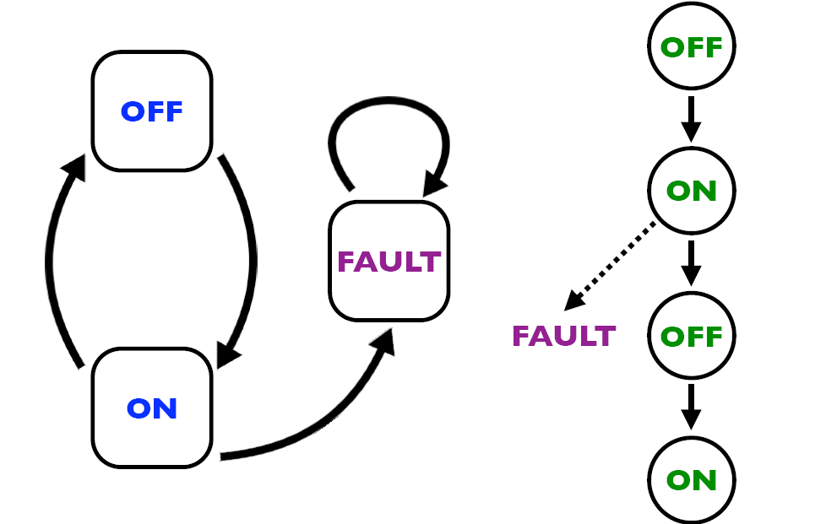
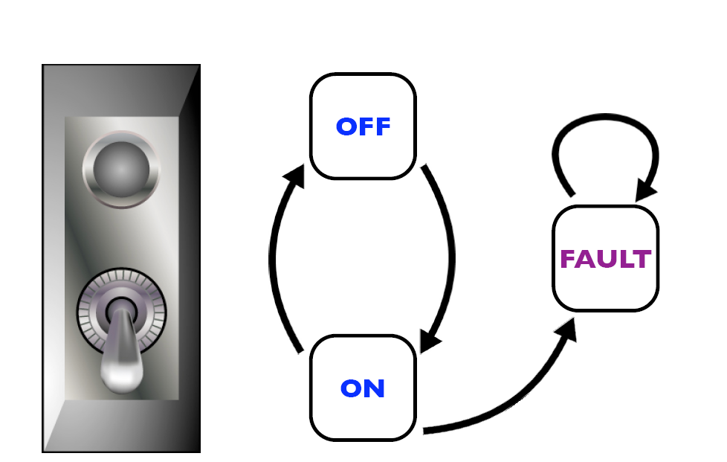
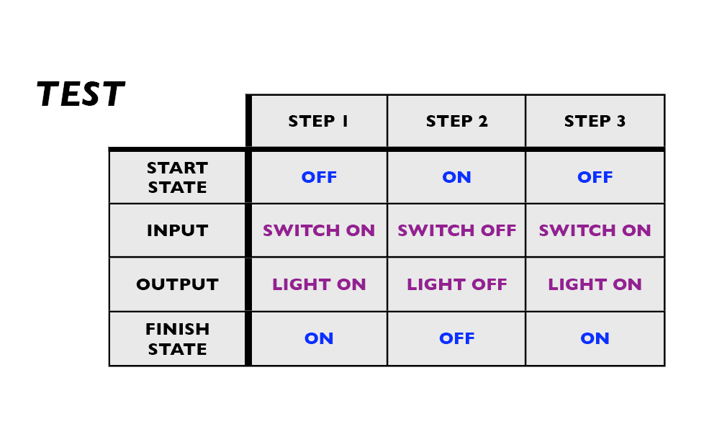
State transition testing

Slide 21
Decision table testing
Decision table testing
• useful when requirements have been specified as
“if-then” rules

Slide 22
Decision table testing
Requirements of certain programs are specified by decision tables.
A decision table is useful when specifying complex decision logic

Slide 23
Decision table testing s
A decision table has two parts:
  condition part
  action part
The two together specify under what condition will an action be performed.

Slide 24
Decision table testing
    C: denotes a condition
    A: denotes an action
    Y: denotes true
    N:denotes false
    X: denotes action to be taken.
    Blank in condition: denotes “don’t care”
    Blank in action: denotes “do not take the action”

Slide 25
Bank Example
Consider a bank software responsible for debiting from an account. The relevant conditions and actions are:
    C1: The account number is correct
    C2: The signature matches
    C3: There is enough money in the account
    A1: Give money
    A2: Give statement indicating insufficient funds
    A3: Call vigilance to check for fraud!

Slide 26
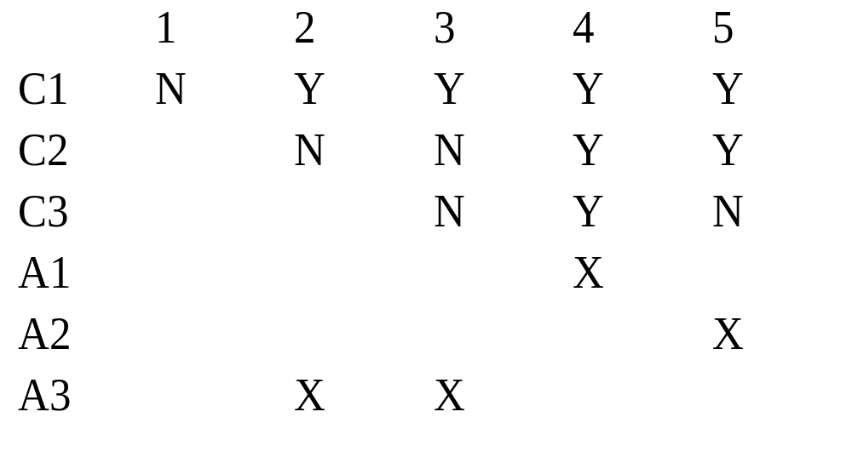
Decision table testing

Slide 27
Example (contd.)
A1 is to be performed when C1, C2, and C3 are true.
A2 is to be performed when C1 and C2 are true and C3 is false.
A3 is to be performed when C1 is true and C2 is false.

Slide 28
Use case testing
Use case testing

Slide 29
Structure-based or white-box techniques
Coverage
The coverage of a set of test cases is a measure of the proportion of statements, branches or paths covered by the set of test cases.
Statement coverage, branch coverage and path coverage are white box testing techniques that are used to propose test cases based on the logical structure of a program

Slide 30
Designing Test Cases for Coverage
Analyse source to derive flow graph
Propose test paths to achieve required coverage from the flow graph
Evaluate test conditions to achieve each path
Propose input and output values based on the conditions

Slide 31
Example
  enrol(student, tute) {
  A if student already in tute
  B display “already enrolled in tute”
  else
  C if tute is full
  D display “tute requested is full”
  else
  E add enrolment record for student in tute
  display “enrolment successful”
  F end if
  G end if
  }
A
B
C
D
E
F
G

Slide 32
Statement Coverage
Statement coverage of a set of test cases is defined to be the proportion of statements in a unit covered by those test cases.
100% statement coverage for a set of tests means that all statements are covered by the tests. That is, all statements will be executed at least once by running the tests.

Slide 33
Example – Statement Coverage
A
Total Nodes = 7
Test case ABG covers 3/7 = 43%
+
Test case ACDFG
Now covers 5/7 = 71%
Need 1 more fore 100% statement coverage - ACEFG
B
C
D
E
F
G

Slide 34
Example – Defining test cases
  enrol(student, tute) {
  A if student already in tute
  B display “already enrolled in tute”
  else
  C if tute is full
  D display “tute requested is full”
  else
  E add enrolment record for student in tute
  display “enrolment successful”
  F end if
  G end if
  }
For 100% statement coverage need 3 cases:
ABG,
ACDFG,
ACEFG
ABG – conditions: student already in tute.
expect: display “already enrolled in tute”

Slide 35
Branch Coverage
Branch coverage is determined by the proportion of decision branches that are exercised by a set of proposed test cases.
100% branch coverage is where every decision branch in a unit is visited by at least one test in the set of proposed test cases.

Slide 36
Example – Branch coverage
A
What branch coverage is achieved by ABG, ACDFG, ACEFG?
4 in total.
4 covered
So 4/4 = 100% branch coverage
B
C
D
E
F
G

Slide 37
Path Coverage
Path coverage is determined by assessing the proportion of execution paths through a unit exercised by the set of proposed test cases.
100% path coverage is where every path in the unit is executed at least once by the set of proposed test cases.

Slide 38
Example – Path coverage
A
What path coverage is achieved by ABG, ACDFG, ACEFG?
3/3=100%
B
C
D
E
F
G

Slide 39
Coverage
100% path coverage implies 100% branch coverage and 100% branch coverage implies 100% statement coverage

Slide 40
Experience-based techniques
Random Testing
Exploratory Testing
Error Guessing

Slide 41
Random Testing
A non systematic techniques
  Should be used only after systematic techniques have been exhausted
  Involves picking a set of test cases randomly from the present test
  No set approach in selecting test cases
  Also known as Guerilla testing and Monkey Testing

Slide 42
Other Techniques
Exploratory Testing
“Exploratory testing is simultaneous learning, test design and test execution“
James Bach
  Test cases are not defined in advance
  Outcome of one test case determines the next test case
  Very useful in rapidly changing environments
  Useful aid after all other techniques have been exhausted

Slide 43

Other Techniques
Error Guessing
Much ad hoc testing is based on intuition and guesswork and there are good reasons why this helps us to derive useful tests
  Some people have a knack of finding bugs
  Good test cases can be derived in this way
  Example:
A menu system might be tested by entering same command repeatedly, screens entered and exited immediately entered, transactions aborted, re-entered, deleted then searched for.

Slide 44
Usage
Techniques like Exploratory testing and Error Guessing should never be used!
True ? False?
Both these techniques are widely used and used best by experienced testers.
Every Tester should use these techniques to increase the effectiveness of their Test Cases.

Slide 45

Risk Based Testing
Wise Quote: Anything that can go wrong, will.
(Larry Niven)

Slide 46
Risk Based Testing
So much to test , so little time !

Slide 47
Risk Based Testing
Always Prioritize based on Risk of the system
  Questions to ask:
  What does the client require most?
  What is most critical to the System?
  What has been explicitly stated?
  What has been implicitly understood?
  Have you highlighted the risks and followed the mitigation steps?

Slide 48
Risk Based Testing
The answers will help you identify:
what to test first
  what to test most
  how thoroughly to test each item
  what not to test (this time)
  Also:
  Use test results to refine the risk analysis.
  Don’t neglect other low-risk areas - what if your risk analysis is wrong !

Slide 49

Risk Based Testing
Examples:
One component has suffered from various attacks like:
  Changing requirements
  Change in development Team
  High defects in earlier phases
This component would pose a very high product risk, but does it pose a high project risk also?

Slide 50
Risk Based Testing
Ask the following questions to get the answer :
  Is the component a business critical requirement?
  Is the component set to be delivered in this release?

Slide 51
Choosing the right technique
The choice of which test techniques to use depends on a number of factors, including
type of system,
regulatory standards,
customer or contractual requirements,
level of risk, type of risk,
test objective,
documentation available,
knowledge of the testers,
time and budget,
previous experience of types of defects found, etc
Some techniques are more applicable to certain situations and test levels; others are applicable to all test levels.

Slide 52
Thank You

